Slide 1
Annual Meeting 2022
Ms. Katherine Escobar
Joint Staff J6, DDC5I, Data & Standards
NIEM Managing Director
Notes:
Hello and welcome to an overview of how NIEM, the State Local Tribal and Territorial, and the Cybercrime Support Network will assist you to solve your data interoperability concerns while concurrently implementing the NIEM Cyber Domain.

Slide 2
Agenda
Looking Back
2021 ESC: Transition NIEM to an OASIS OPEN Project Standard
Rationale
Timeline
NIEM OPEN
Migrate Governance to NIEM OPEN
Transition Progress
Founding Sponsors & Potential Candidates
ESC Transition & PGB Kickoff
2022 Successes
Next Steps
Notes:
For the Agenda, we will cover:
A discussion on the Interoperability Challenges plaguing most organizations
An overview The National Information Exchange Model, (NIEM), and how it can help to resolve some of these challenges
The State Local Tribal Territorial NIEM Pilot effort for Cyber Incident Response & Reporting
And Next Steps
So let’s get started

Slide 3
Looking back
September 2021 the NMO briefed the ESC on alternatives for NIEM sustainability
Reviewed results of NMO 2020-2021 study focused on NIEM becoming a formal standard
Presented trade-offs associated with joining various standards organizations
Recommended transition to an Open Standard
Recommended joining OASIS OPEN
ESC Approved NIEM Transition to an OASIS OPEN Project

Slide 4
Reasons for NIEM an Open-Source standard
Aligns with the Law mandating the use of voluntary consensus standards over government developed standards:
National Technology Transfer and Advancement Act of 1995 (NTTAA), Public Law 104-113
Government at every level favors standards - OMB 119
Align with NIST the government cited assessment body for compliance of systems
Government and Industry favors formal standards
Inherent Interoperability due to rigor in vetting standards
Increases awareness of NIEM to larger audience
NIEM already meets most of the criteria for becoming a standard
Increased visibility, contribution, and use by open-source tool developers
Compliance argument over competing government developed standards
Notes:
National Technology Transfer and Advancement Act of 1995 (NTTAA), Public Law 104-113 requires all federal government agencies to use, wherever feasible, standards developed or adopted by voluntary consensus standards bodies in lieu of developing government-unique standards or regulations
OMB 119 maintains a strong preference for using voluntary consensus standards over government to unique standards in Federal regulation and procurement
NIEM included in other standards
ANSI 42.42 Radiological Nuclear detectors
ANSI APCO Alarm Monitoring Company to Public Safety Answering Point (PSAP)
OASIS EXDL FEMA
NIST Big Data Framework Vol 7
Nation Fire Protection NFPA 950 calls for compliance with NIEM. Emergency Incident Data Document (EIDD) IEPD – NISTIR 8255
Biometrics ANSI/NIST ITL Standard
Biometric Conformance Test Software (BioCTS)
BioCTS for AN-ITL v2 is a desktop application which tests electronic biometric data files, known as transactions, for conformance to NIST Special Publication (SP) 500-290
Conformance Test Architecture (CTA) and Test Suite (CTS) called "BioCTS for AN-2011 NIEM XML" designed to test implementations of AN-2011 NIEM XML encoded transactions.
NIEM Cited in patent – Integrated Environment for Developing Information Exchanges patent No: US 8,769,480 B1 Dated July 1, 2014
Combination of Interoperability Registries with Process and Data Management tools for Governmental Services

Slide 5
Standards that include NIEM
ANSI APCO Alarm Monitoring Company to Public Safety Answering Point (PSAP)
OASIS EXDL, Emergency Data Exchange Language FEMA (Emergency Management Domain)
Nation Fire Protection NFPA 950 calls for compliance with NIEM. Emergency Incident Data Document (EIDD) – NISTIR 8255
Model Minimum Uniform Crash Criteria Guideline (MMUCC) – Department of Transportation
ANSI 42.42 Radiological Nuclear detectors – CBRN Domain
NIST Big Data Framework Vol 7
Biometrics ANSI/NIST ITL Standard – Biometrics Domain
Biometric Conformance Test Software (BioCTS)
BioCTS for AN-ITL v2 is a desktop application which tests electronic biometric data files, known as transactions, for conformance to NIST Special Publication (SP) 500-290
Conformance Test Architecture (CTA) and Test Suite (CTS) called "BioCTS for AN-2011 NIEM XML" designed to test implementations of AN-2011 NIEM XML encoded transactions.
NIEM cited in patent – Integrated Environment for Developing Information Exchanges patent No: US 8,769,480 B1 Dated July 1, 2014
Notes:
Another point to highlight is that you may be using NIEM and not even know it.
NIEM has been incorporated and leveraged by several other industry standards as identified on this slide. If you are currently using any of these standards, you are technically using NIEM as well.

Slide 6


Slide 7




NIEM Transition and Timeline
Phased approach Open Standard – 24 months
Phase 1 (12 months): Preparation (Governing Documentation and Sponsor Commitments)
Phase 2 (12 month): Formal Transition to OASIS (NMO)
Due Diligence
FY21
Create New Governance
FY22
Formal Transition
FY23
NIEM OASIS Standard
Oct 24
Scope Definition and Analysis
NBAC/NTAC Endorsement
ESC Approval
Transition Team Standup
Transition Kickoff (JS J6 $25K commitment)
Governance, Marketing & Development
Charter & Governance development
Awareness Campaign
Domain Steward Transition Workshop
Project Governance Board Sponsorship Drive
Marketing & Development
Shadow and Reverse Shadow
OASIS NIEM Committee Membership
Shadow NIEM OASIS PGB
Selected projects transferred
Intellectual capital transferred
Final ESC Turnover
NIEM OASIS Open Standard
NIEM Major Projects Transition
NIEM OASIS
NIEM Management Office
Annual Model update
Meeting Management
Training
Marketing
Enterprise Tools
MilOps and JS J6
Restricted (CUI) Repository
NIEM.gov website
Sponsors hold 1 vote on the Project Governing Board (PGB)

Slide 8
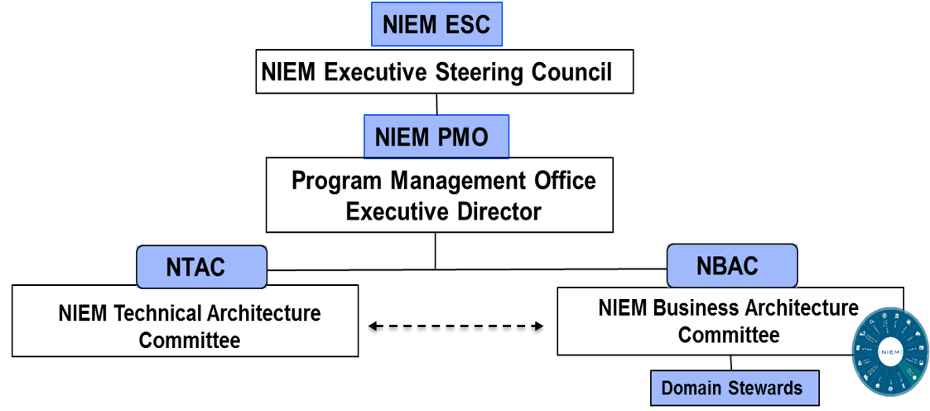
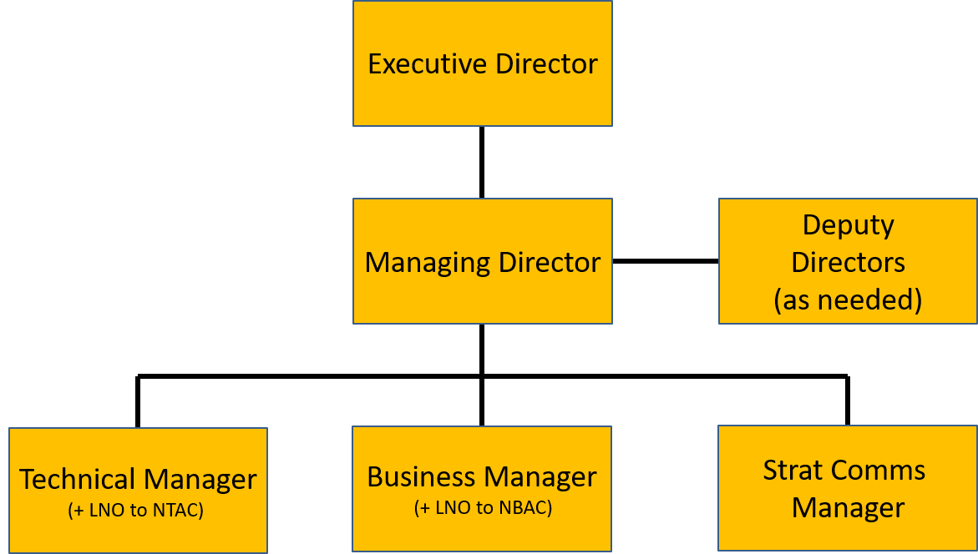
NIEM Organization Governance
NIEM provides standardized enterprise-level information exchange across Joint, Coalition and Interagency domains
Chaired by DOD CDAO
Quarterly or every 6 months
DOD CDAO
JS J6
Led by JS J6 SES Mr. Whitehead
Conducts day-to-day management
JS6 provides NTAC and NBAC LNO
Oversees face-to-face stakeholder sessions
Internal NIEM MO structure manned by JS6 personnel
2 co-chairs + 12 selected Subject Matter Experts from across Gov’t and industry
- Focuses on technical specifications
Implementing NBAC business requirements
2 co-chairs + 40 members in 17 functional domains from across Federal / State / Local / Tribal / Territorial Gov’t plus international
- Focuses on model content
Notes:
NIEM’s governing structure is comprised of:
The NIEM Executive Steering Council (ESC): is NIEM’s decision-making body regarding membership, funding requirements, program or technical direction, personnel appointments, and other organizational decisions as required for supporting NIEM management.
The NIEM Management Office (NMO): executes the vision of NIEM coordinated among the NIEM Business Architecture committee (NBAC), NIEM Technical Architecture committee (NTAC), NMO, and the ESC. The NIEM NMO encourages the adoption and use of NIEM and oversees working group and committee activities. The NIEM NMO coordinates with COIs, principal stakeholders, and other information-sharing initiatives to promote collaboration and interest in NIEM priorities.
The NIEM Business Architecture Committee (NBAC): guides the business requirements, harmonization or those requirements across mission needs, evolution, and implementation of NIEM Core and its domains. The NBAC also defines and governs the foundation and processes for establishing and supporting the participation of NIEM domains through a federated governance approach.
And the NIEM Technical Architecture Committee (NTAC): defines the technical architecture associated with NIEM development and implementation, and develops, implements, and maintains the technical specifications for the NIEM community.

Slide 9
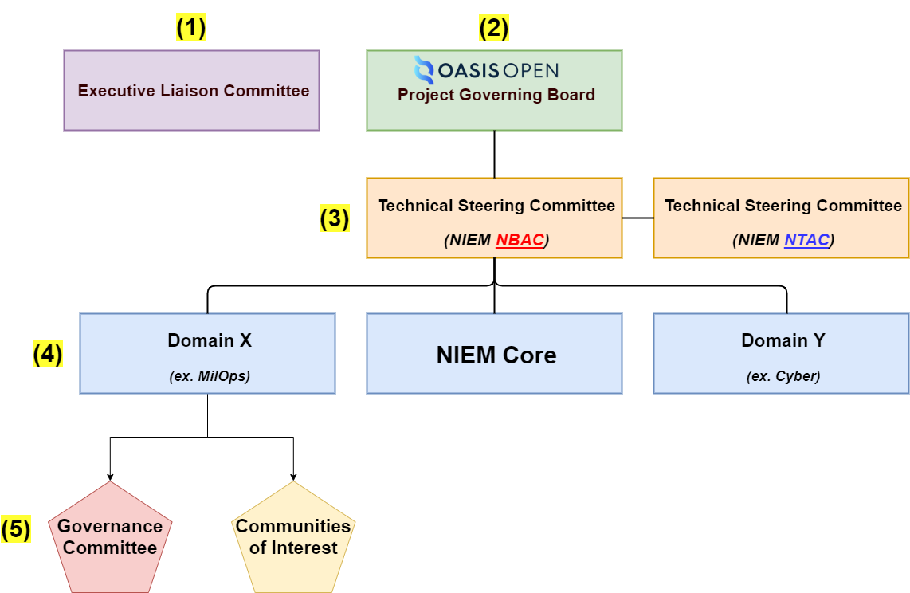
NIEM Moves to OASIS
Becomes: an OASIS “Open Project”
Why the Move: it’s the next logical NIEM maturity step and allows NIEM to be designated a standard. This move shifts leadership and resourcing to the OASIS user community.
NIEM “As Is” “To Be”
NIEM ESC – becomes Executive Liaison Committee
NIEM Management Office – becomes Project Governing Board
NIEM Technical and Business Architecture Committees – becomes Technical Steering Committees
NIEM Domain Stewards – no change
Tiger Teams – no change
Lead Developer – funded by OASIS and Project Governing Board
NIEM Core Steward – OASIS Technical Steering Committees
Selected Membership Considerations
Federal CDAO Council co-chairs invited to be a member of Executive Liaison Committee
DoD CDAO invited to be a member of Executive Liaison Committee
Domains invited to be a member of the Project Governing Board
Joint Staff J6 member of the Project Governing Board
Joint Staff J6 retains MilOps Doman stewardship
International participation encouraged at all levels

Slide 10
NIEM Open Milestones & progress
Complete
Draft POA&M
Draft and publish NIEM Open Charter
Draft TSC Governance Docs
J6 Sponsorship/Founding Sponsors
Transfer NIEM Community Rosters/Establish NIEM Open Mailing Lists
Conduct First Sponsor Kickoff Mtg
OASIS Admin Privileges
Web Presence (NIEMOpen.org)
Jira/Confluence
New Logo/Branding
In Progress
Identify Potential Sponsors/Conduct Outreach
Reviewing NBAC & NTAC TSC Documents
Populating OASIS Jira & Confluence Site
Updating NIEM Branding
Building Out NIEMOpen.org
Weekly Synch w/ OASIS Staff
Assessing NIEM Model & NIEM GTRI GitHub Capital/Equities & Planning Transfer to OASIS
Outlining OASIS Release Process and Planning 1st Release Under OASIS
Planning PGB Kickoff
To Be Accomplished
Transition ESC and Domains
Kickoff PGB
Establish Technical Steering Committees (TSC), NBAC & NTAC
Appoint NBAC & NTAC Co-Chairs
Appoint TSC Liaisons to PGB
Establish NIEM Open Git Repo
Appoint Git Maintainers
Obtain contributor license agreements (CLAs)
Physically Transfer NIEM Capital/Equities (Model, Specifications, Documentation) to OASIS
Implement “New” development and release processes
Issue 1st release under NIEM Open

Slide 11
NIEM OPEN sponsorship
Current Founding Sponsors
Joint Staff J6
DHS S&T
Equivant
Potential Candidates
DHS OBIM – leaning toward sponsorship
Veterans Affairs – leaning toward sponsorship
Oracle – interested
Department of National Defence/CA – progress toward
Other Potential Sponsors: BJA, OJP, State of Virginia, Microsoft, Apple

Slide 12
NIEM Governance: esc & pgb
ESC Transition and NIEM OPEN PGB Kickoff tentatively on 20 Oct (Live & Virtual Event)
ESC
Transition ESC Governance
ESC Members Serve in Advisory Capacity to PGB
Solicit Sponsors
PGB Kickoff
Install PGB
Nominate Chair
Establish TSCs (NBAC &NTAC) and Install Co-Chairs/ Liaisons
Install Maintainers
Best-of-NIEM Awards

Slide 13
2022 Successes

Slide 14

key accomplishments
NIEM 5.1 Restricted Content Release (Q1 CY 2022)
NIEM 5.1 Minor Release (Dec 2021)
“New” Cyber Domain (Approved 2019) adds content NIEM 5.2 Alpha
2 NEW Domains Approved 2021
Learning & Development Domain (Approved 2021)
International Human Services Domain (Approved 2021)
OASIS Transition Start-up (Sept 2021/2022)
Founding Sponsors
NIEM Open Charter & POAM
NIEM Tools & Restricted Registry/Repository (R2) Development (2022)
Message Exchange Package (MEP) Tool Phase 1 Released
Restricted R2 Released, Being Populated (JNKE IEPD, first R2 IEPD in system, and MOMS releases)
Updated API functionality to support multiple releases and new Message Builder tool
Notes:
Defense Counterintelligence and Security Agency (DCSA) DoD Contract Security Classification - NIEM conformant DD 254 document Automated via NIEM saving time and money

Slide 15







State, Local , Tribal & Territorial (SLTT) Tiger Team
2022 Accomplishments:
DAMA Briefings
DAMA Chicago Chapter (1/4/22)
DAMA Michigan Chapter (2/16/22)
DAMA Calgary (3/17/22)
DAMA Portland Chapter (5/19/22)
DAMA – DMBOK (Data Management Body of Knowledge)
Working with DAMA International
to incorporate a section addressing
NIEM
Arizona Criminal Justice Commission Presentation (4/18/22)
Utility Analytics Institute (UAI) Presentation (4/21/22)
2022 Accomplishments (cont.):
Nation Science Foundation Open Knowledge Network (OKN)
Developed Use Cases
NIEM Ontology
Decarceration
Mutual Aid
Family Unification
Criminal Justice Enterprise Tracking
Continue OKN Sprint (MAR-JUN 22)
Prep for NSF Solicitation
Other Outreach
SIEMENS Calgary
Kantara (Identity Assurance)
NIEM Open Sponsorship
SLTT collaboration with OASIS to
Identify and solicit NIEM Open sponsors

Slide 16

NIEM TRAINING
Entire Program Reorganized
Follows the Message Specification (formerly IEPD) creation process
Attendees learn technical concepts in the context where they apply
Virtual Instructor Lead Sessions (SEP 21, NOV 21, JAN 22, FEB 22, MAR 22, APR 22, MAY 22, JUN 22)
Ask-An-Expert” Live Q&A (May 22 Pilot)
Hybrid Pilot (JUL 22)
Development & Pilot of Hybrid Sessions (Asynchronous Instructor Monitor)
DVIDS – Defense Visual Information Distribution Service Video Recordings
Combined with trainer availability to answer questions
JULY/AUG 22 Pilots
Future
Host Commercially - online training providers
LinkedIn
Coursera
Skillsoft
Build Instructional Pool
Formalize materials
Train-the-Trainer sessions

Slide 17
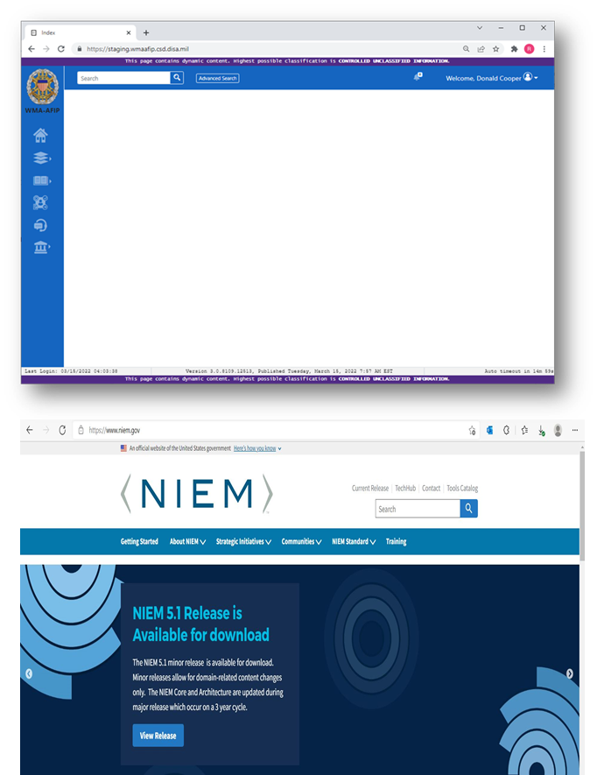
NIEM IEPD Registry & repository status
Restricted R&R
WMA-AFIP selected for restricted R&R, hosted by MS Azure Govt.
IL5 – NIPRNET
IL6 – SIPRNET
Launched: May 2022
Populating with IEPDs/Message Specification and MOMS releases
Joint Non-Kinetic Effectiveness (JNKE) IEPD
Warfighting Mission Area Architecture Federation and Integration Portal (WMAAFIP) IEPD
Maritime IEPD (In Progress)
Restricted content releases (MilOps Mission Specific (MOMS)) 5.1 Distribution Statement C and D releases
Migrate from milCloud to Amazon Web Services GovCloud CY 22
Enables all PIV holder access
https://wmaafip.js.mil/
Public R&R
DHS will host Public IEPD R & R using niem.gov website

Slide 18
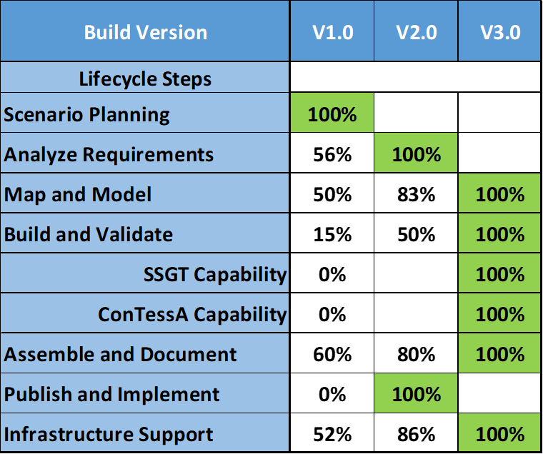
Message Exchange Package (MEP) Tools Buildout Update
NIEM Tools v2.0 Development
Continue enhancement of NIEM Lifecycle Tools Suite
Build additional functionality in IEPD development steps started in v1.0
Expand capability in Assemble & Document & Publish and Implement Lifecycle Phases
Message Specification Lifecycle Tool Suite Available
NIEM Tools v3.0 Considerations Pending Funding 2023
Build functionality that replaces SSGT and ConTessA
Complete requirements to develop Message Specification Lifecycle
https://sourceforge.net/projects/niem-mep-builder/

Slide 19

Next steps
Continue Transfer of NIEM Equities to OASIS
Continue to Solicit Sponsors
Transition ESC
Conduct PGB Kickoff 20 OCT
Stand-up Technical Steering Committees
Stand-up Git Repository
Migrate Domains
Deliver 1st Release Under NIEM OPEN

Slide 20
Reference Material
Starting Point: https://www.niem.gov/
OSIS OPEN: https://www.oasis-open.org/
NIEMOpen.org: https://niemopen.org/ (Under Construction)
Training: https://niem.github.io/training/
Technical Resources: https://www.niem.gov/techhub
Current Release: https://niem.github.io/niem-releases
IEPD Developer Resources: https://www.niem.gov/techhub/iepd-resources
Implementation Support: https://niem.github.io/
Tools: https://www.niem.gov/tools-catalog
SLTT Tiger Team: http://niem.github.io/community/sltt/

Slide 21

Contact Us
NMO Katherine Escobar (Katherine.b.escobar.civ@mail.mil), 757-203-8631
NMO Steve Sullivan (stephen.m.sullivan14.ctr@mail.mil), 757-203-8619
NBAC TSC Kamran Atri (katri@a4safe.com), 703-930-6057
NBAC TSC Thomas Krul (Thomas.krul@Canada.ca), 613-949-6513

Slide 22


Questions & Answers
Mr. Kamran Atri & Mr. Thomas Krul Facilitators

